Slide 1
Next-Generation Sequencing: Technology, Mapping, and Analysis
Gary Benson
Computer Science, Biology, Bioinformatics
Boston University
gbenson@bu.edu
http://tandem.bu.edu/

Slide 2
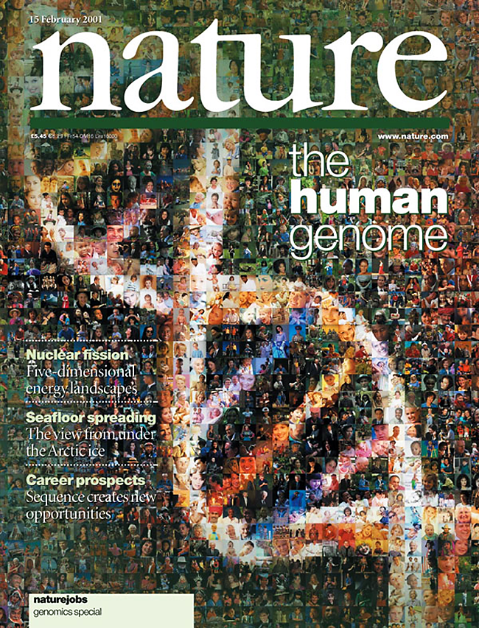


Slide 3
The Human Genome Project took 10 years and cost roughly $3,000,000,000 by 2001. (€ 2,660,871,930 at today’s conversion rate)

Slide 4
The Human Genome Project took 10 years and cost roughly $3,000,000,000 by 2001. (€ 2,660,871,930 at today’s conversion rate)
But, we had only one, maybe two, versions of the human genome, therefore, little data for a comprehensive, systematic study of human genetic diversity.

Slide 5
The Human Genome Project took 10 years and cost roughly $3,000,000,000 by 2001. (₺8,478,000,000 at today’s conversion rate)
But, we had only one, maybe two, versions of the human genome, therefore, little data for a comprehensive, systematic study of human genetic diversity.
My lab has data from 2 whole human genomes, stored on a hard drive from 2010. Each cost roughly $40,000. Today (2017) the wholesale cost of sequencing a genome is ~$1,245.

Slide 6
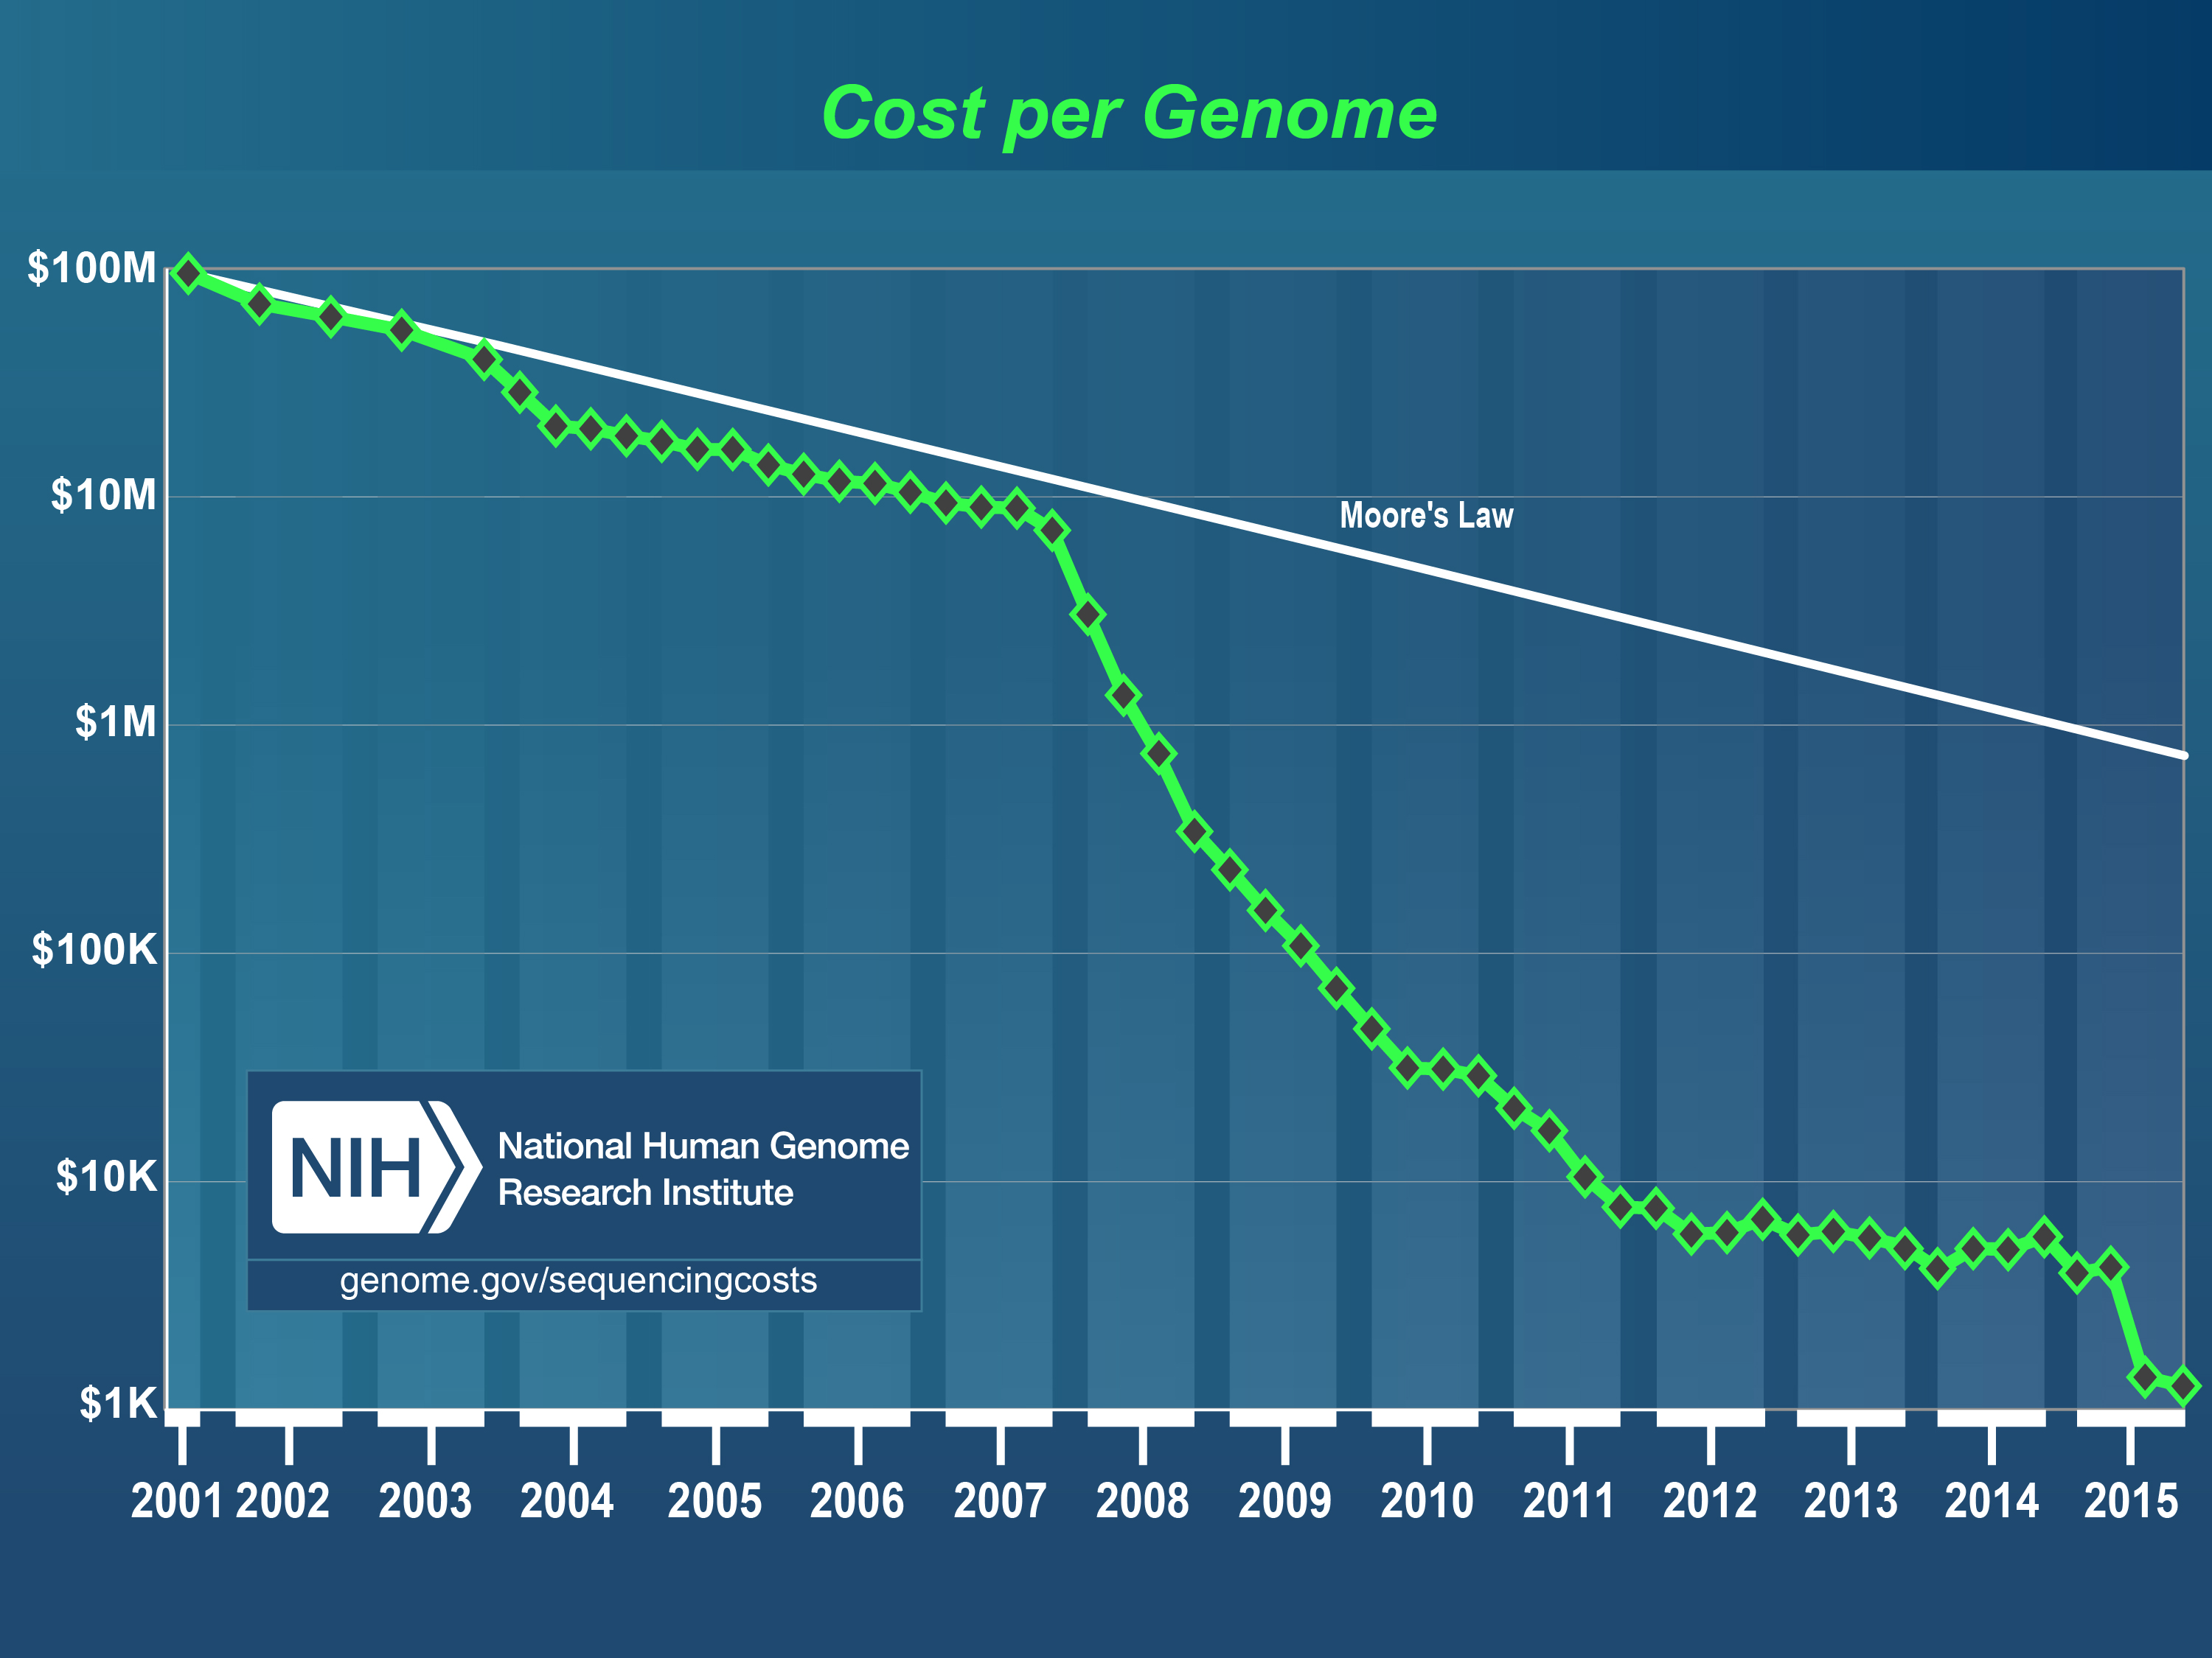
NIH Estimate of Sequencing Costs

Slide 7
Outline
Next Generation Sequencing Technologies
Algorithms for Mapping Reads
Detecting Structural Variants
Visualization Software

Slide 8
Why Sequence DNA?
DNA is the molecule of genetic inheritance.
Sequencing data provide a fundamental basis for understanding the biology of an organism.
The data allow comprehensive comparisons of organisms on a genomic level to find regions of similarity, difference, and functional significance.

Slide 9
Why Sequence DNA?
The data allow us to understand Human genetic variation on a molecular level, for example, the genetic differences between tumor and normal tissue.
This will hopefully lead to more specific medical treatments (personalized medicine).

Slide 10
Current Experimental Methods That Use Sequencing
RNAseq – mRNA expression quantification, microRNA expression quantification, alternative splicing detection and quantification
ChIPseq – (chromatin immunoprecipitation) Identification of protein binding sites on DNA.
CLIPseq – (cross-linking immunoprecipitation) Identification of protein binding sites on RNA.

Slide 11
Current Experimental Methods That Use Sequencing
Bisulfite sequencing – bisulfite conversion of methylated cytosine (C) to uracil (U) followed by high-throughput sequencing to determine sites of epigenetic methylation.
Whole genome sequencing – allows detection of SNPs (single nucleotide polymorphisms) and structural variations.

Slide 12
Next Generation Sequencing Technologies
Current and improving:
Illumina Genome Analyzer
Roche 454
Pacific Biosciences SMRT
Ion Torrent
Nanopore sequencing

Slide 13
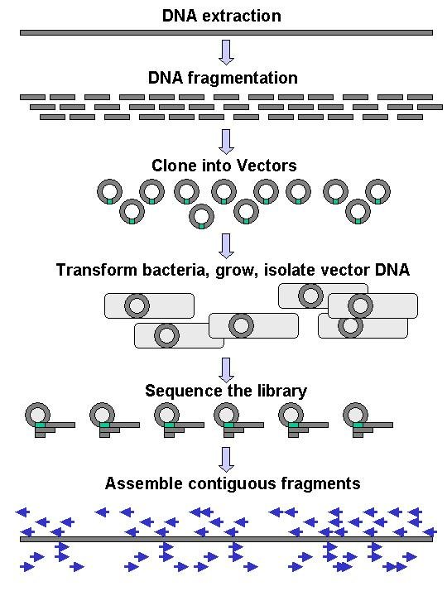
Sanger Sequencing
http://upload.wikimedia.org/wikipedia/en/6/60/DNA_Sequencing_gDNA_libraries.jpg

Slide 14
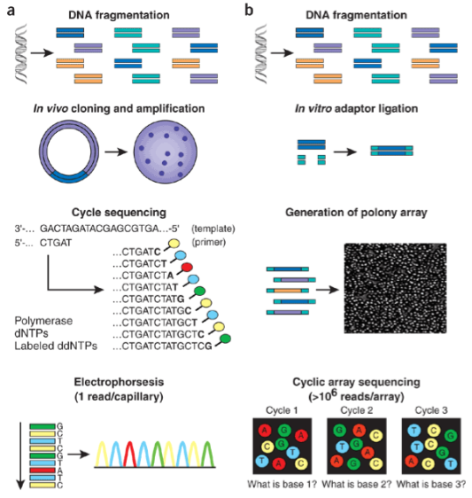
Sanger vs NGS technology
http://www.nature.com/nbt/journal/v26/n10/fig_tab/nbt1486_F1.html
Next-generation DNA sequencing by Jay Shendure and Hanlee Ji,
Nature Biotechnology 26, 1135 - 1145 (2008), doi:10.1038/nbt1486

Slide 15
Sanger vs NGS technology
$/€ 0.10 per megabase
$/€.50 per kilobase
http://www.nature.com/nbt/journal/v26/n10/fig_tab/nbt1486_F1.html
Next-generation DNA sequencing by Jay Shendure and Hanlee Ji,
Nature Biotechnology 26, 1135 - 1145 (2008), doi:10.1038/nbt1486

Slide 16
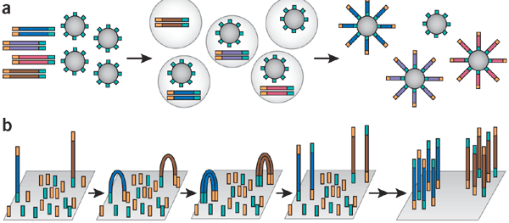
Emulsion and bridge amplification
http://www.nature.com/nbt/journal/v26/n10/fig_tab/nbt1486_F2.html
Next-generation DNA sequencing by Jay Shendure and Hanlee Ji,
Nature Biotechnology 26, 1135 - 1145 (2008), doi:10.1038/nbt1486

Slide 17
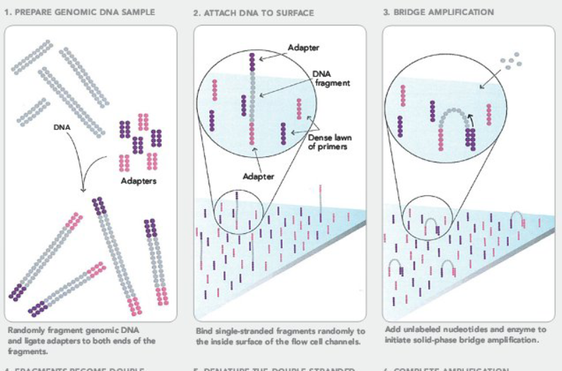
Illumina sequencing technology
http://seqanswers.com/forums/showthread.php?t=21

Slide 18
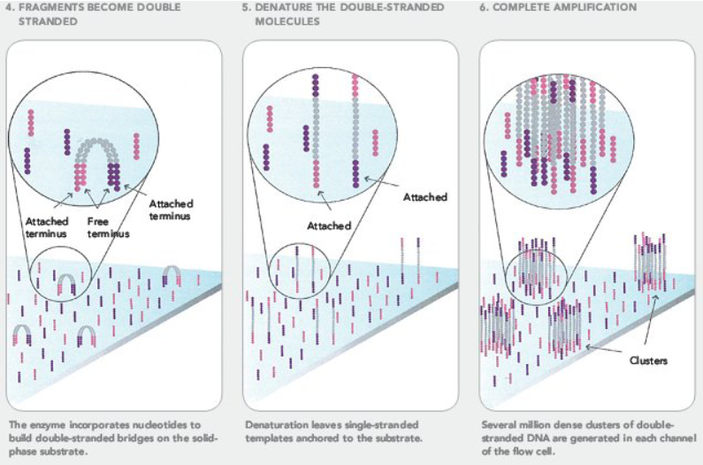
Illumina sequencing technology
http://seqanswers.com/forums/showthread.php?t=21

Slide 19
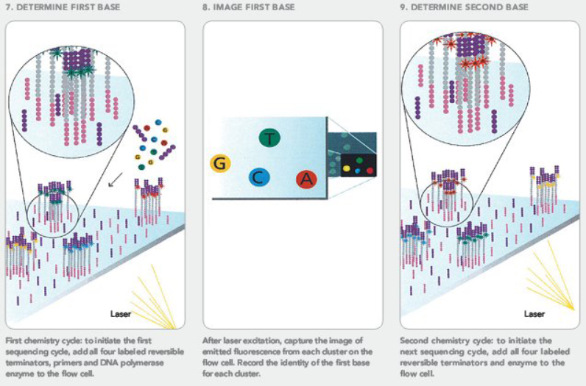
Illumina sequencing technology
http://seqanswers.com/forums/showthread.php?t=21

Slide 20
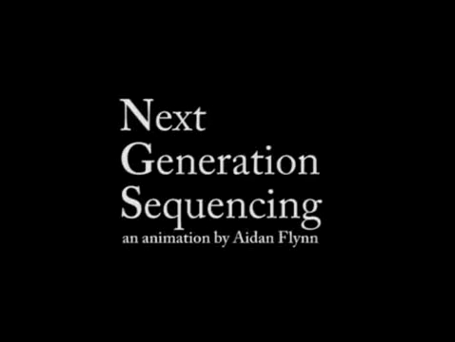
Video of Illumina Sequencing

Slide 21
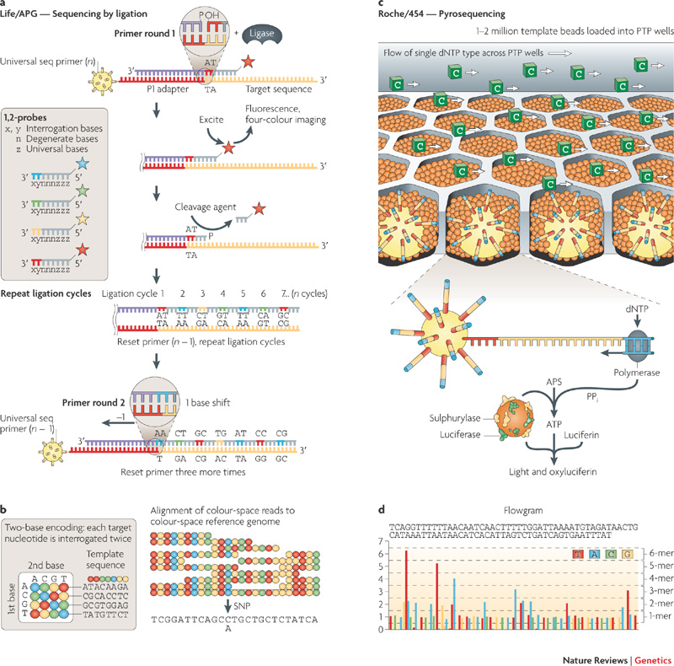
SOLiD and 454 technologies
http://www.nature.com/nrg/journal/v11/n1/fig_tab/nrg2626_F3.html
Sequencing technologies — the next generation by Michael L. Metzker
Nature Reviews Genetics 11, 31-46, doi:10.1038/nrg2626

Slide 22
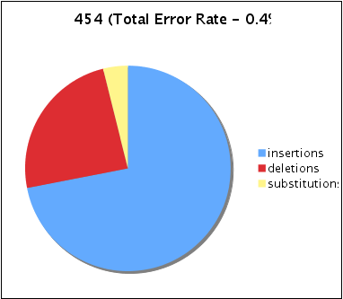
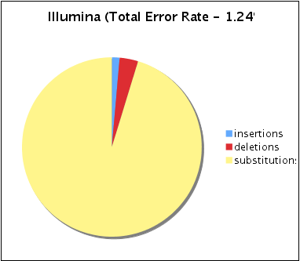

Most Common Error Types:
454 vs Illumina
Roche/454
Illumina/Solexa
Lower overall error

Slide 23
Next-Generation Sequencing Data
These technologies generate millions to billions of short DNA reads sampled from a whole DNA genome, targeted genetic regions, or transcribed RNA.
Length:
35 – 200 nt (Illumina)
200 – 300 nt (454)
1K – 15K nt (PacBio)

Slide 24
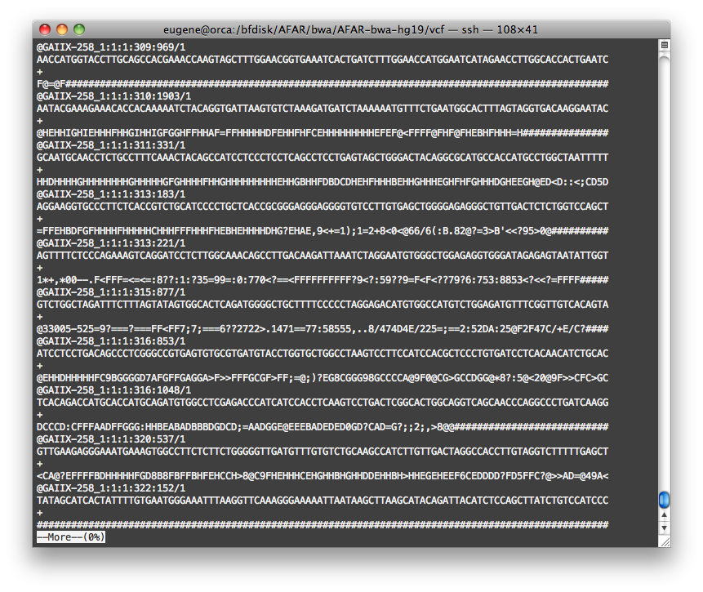

Slide 25
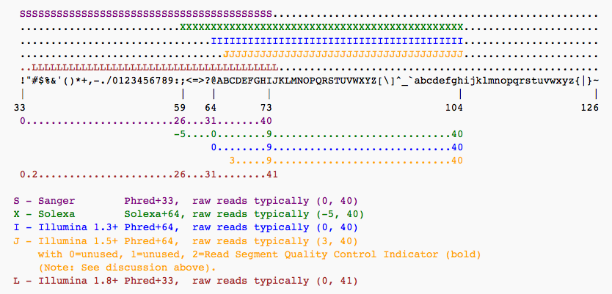
Read Quality Scores
Phred Score Q defines probability P of incorrect call:
P = 10^{-Q/10}
^{error score}
^{1% 20}
^{0.1% 30}

Slide 26
Mapping Reads – the Problem
Given 100+ million reads from an experiment, for each:
1. find the genomic coordinates, chromosome and first base, where it has the best match in a reference genome, either with the forward or reverse strand.
2. best match means zero or a small number of differences with the reference.
3. differences include mismatches and indels.
4. determine if it has multiple matches or none at all.

Slide 27
Algorithms for Read Mapping

Slide 28
Structural Variants
Structural variants are any rearrangements of the genome relative to a reference. They include:
insertions/deletions
inversions
translocations
tandem repeat variations
Many can be detected with paired-end or mate-pair reads.

Slide 29
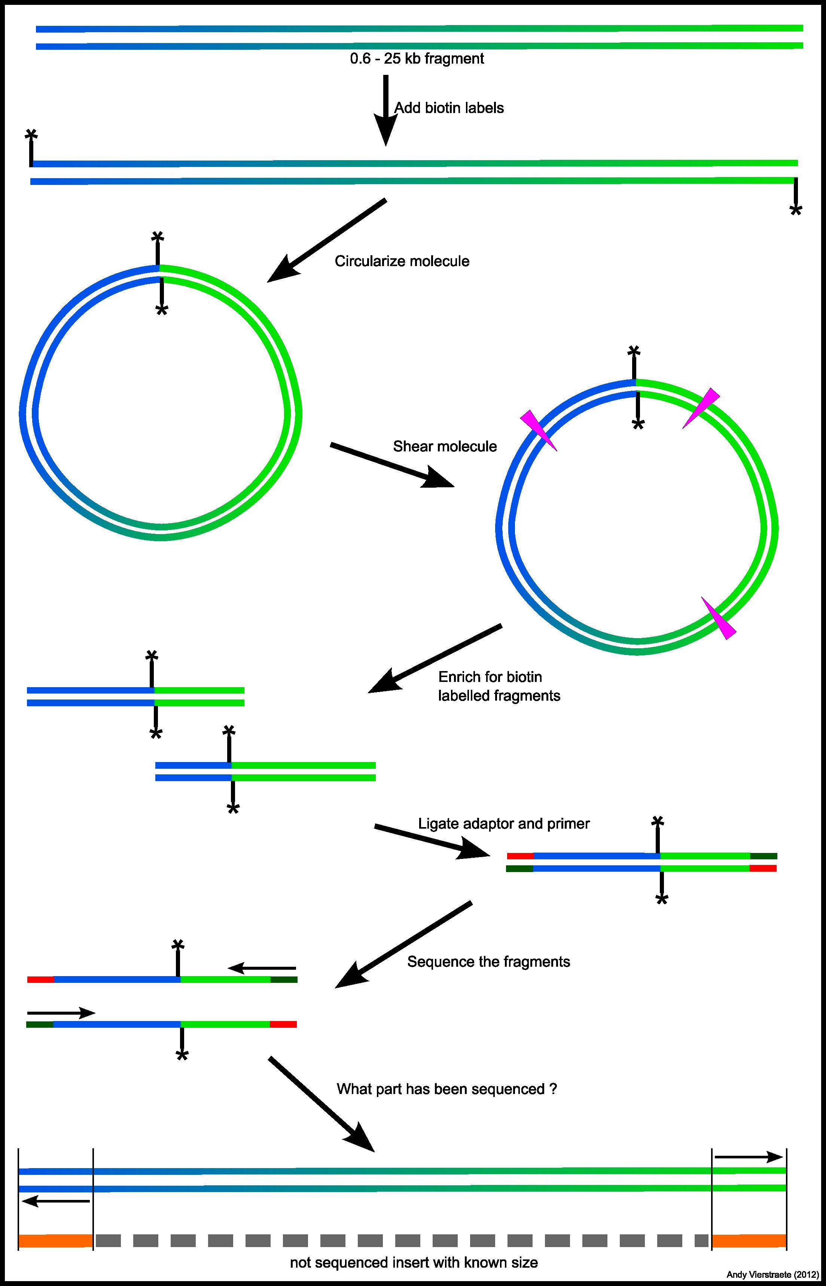
Mate-Pairs
* = biotin label
http://users.ugent.be/~avierstr/nextgen/mate-pair%20sequencing.jpg

Slide 30
Mate-pairs vs paired-ends
Detection of large indels requires large insert sizes.
Current Illumina technology allows for paired-end insert sizes up to 550 bp, which, depending on coverage, allows for detection of small and medium-size indels only.
Mate-pair libraries allow for generation of large inserts at the expense of more insert-size variability.

Slide 31
Normally Mapped Reads
1
2
paired reads
sequenced fragment (insert)
Subject
A
B
C
1
2
mapped reads
Reference
A
B
C
Apparent insert size in
the normally expected range.

Slide 32
Deletion
1
2
paired reads
sequenced fragment (insert)
Subject
A
C
1
2
mapped reads
Reference
A
B
C

Slide 33
Deletion
1
2
Subject
A
C
1
2
Reference
A
B
C
Apparent insert size longer than expected indicating deletion of B.

Slide 34
Insertion
1
2
Subject
A
B
C
1
2
Reference
A
C

Slide 35
Insertion
1
2
Subject
A
B
C
1
2
Reference
A
C
Apparent insert size shorter than expected indicating insertion of B.

Slide 36
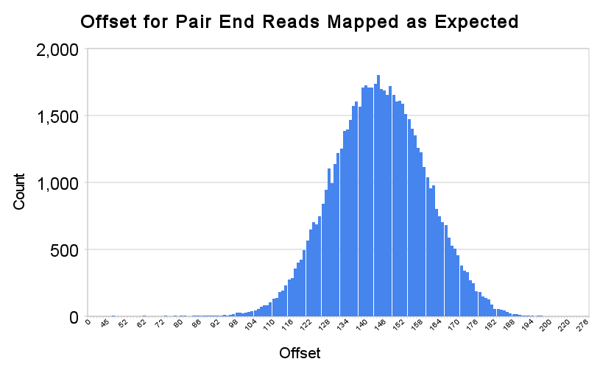
Distribution to determine unusually long or short apparent insert length
Insertions
Deletions

Slide 37
Singletons
A singleton is a read which maps, but whose pair does not map.
Possible causes:
1. Split read
2. Novel insertion

Slide 38
Singleton – Split Read
1
2
Subject
A
C
1
2
2
Reference
A
B
C
Parts of read 2 map to two locations. It is split in the reference. Some mapping programs cannot detect the split mapping.

Slide 39
Singleton – Split Read
1
2
Subject
A
C
1
Reference
A
B
C
Parts of read 2 map to two locations. It is split in the reference. Some mapping programs cannot detect the split mapping.
Only one read mapped

Slide 40
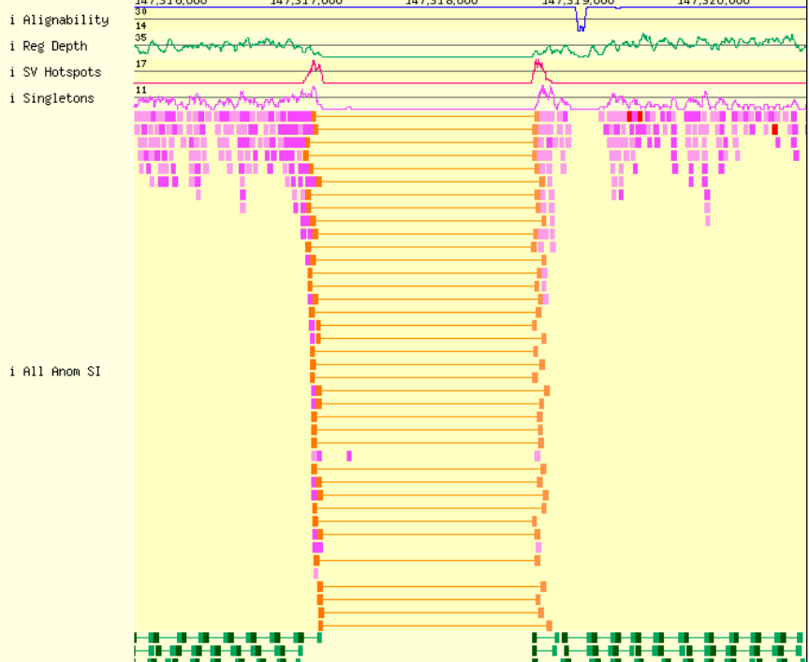
Purple is
singleton
Homozygous deletion
Orange is
long insert
Bentley, et al,
Nature 456, 53-59 (6 November 2008)
doi:10.1038/nature07517;
Green is
normal insert
Notes:
Homozygous deletion. Orange means long insert paired reads. Purple is singletons. Green is normal paired reads.

Slide 41
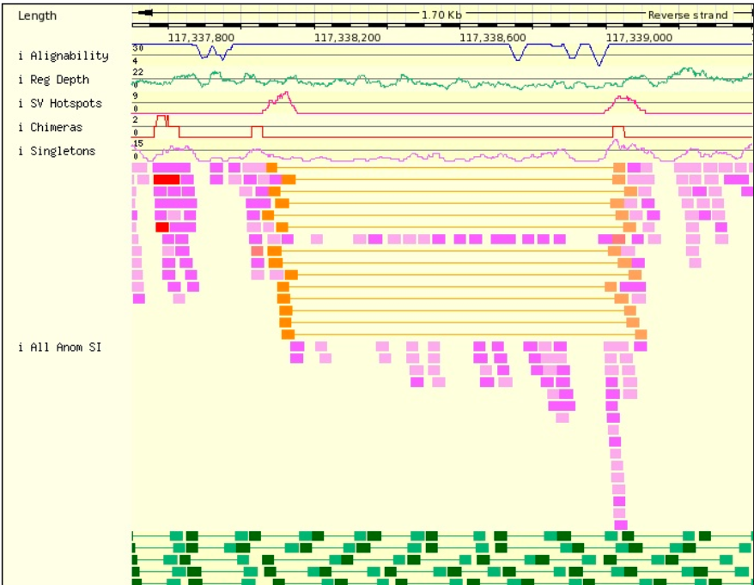
Bentley, et al,
Nature 456, 53-59 (6 November 2008)
doi:10.1038/nature07517;
Gap
Heterozygous deletion
No gap
Notes:
Heterozygous deletion. Orange means long insert paired reads. Purple is singletons. Green is normal paired reads.

Slide 42
Inversion 1
3 prime
5 prime
Reference
A
B C D E F G
H
5 prime
3 prime

Slide 43
Inversion 2
B C D E F G
3 prime
5 prime
Reference
A
H
5 prime
3 prime

Slide 44
Inversion 3
B C D E F G
3 prime
5 prime
Reference
A
H
5 prime
3 prime

Slide 45
Inversion 4
B C D E F G
3 prime
5 prime
Reference
A
H
5 prime
3 prime

Slide 46
Inversion 5
B C D E F G
3 prime
5 prime
Reference
A
H
5 prime
3 prime

Slide 47
Inversion 6
G F E D C B
3 prime
5 prime
Reference
A
H
5 prime
3 prime

Slide 48
Inversion 7
3 prime
5 prime
Subject
G F E D C B
A
H
5 prime
3 prime

Slide 49
Inversion 8
1
2
3
4
Subject
A
G F E D C B
H
1
3
2
4
Reference
A
B C D E F G
H

Slide 50
Inversion 9
1
2
3
4
Subject
A
G F E D C B
H
1
3
2
4
Reference
A
B C D E F G
H
Paired reads map in the same direction
and are farther apart than expected

Slide 51
Inversion 10
1
2
3
4
Subject
A
G F E D C B
H
1
3
2
4
Reference
A
B C D E F G
H
Paired reads map in the same direction
and are farther apart than expected

Slide 52
Inversion 11
1
2
Subject
A
G F E D C B
H
1
2
2
Reference
A
B C D E F G
H
A split read will generally go undetected.

Slide 53
Inversion 12
1
2
Subject
A
G F E D C B
H
2
1
Reference
A
B C D E F G
H
An insert entirely contained in the inversion will look normal, although the positions are swapped.

Slide 54
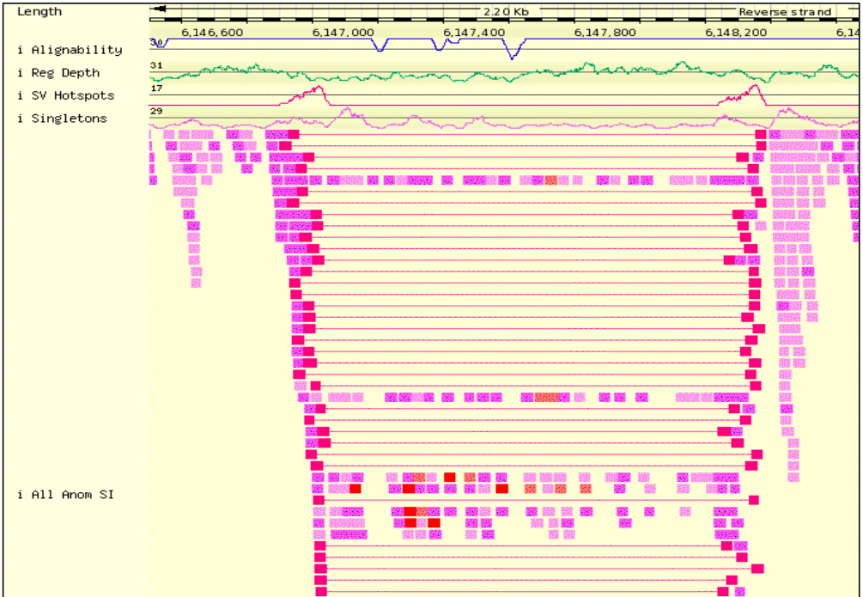
Bentley, et al,
Nature 456, 53-59 (6 November 2008)
doi:10.1038/nature07517;
Homozygous inversion
Red is pair
mapped in the
same direction
Notes:
Homozygous inversion. Red means reads pairs mapped in the same direction. Purple is singletons. See next slide for evidence of homozygosity.

Slide 55
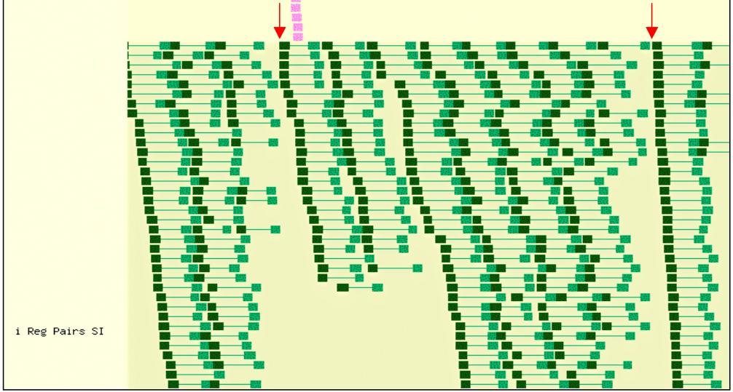
Breakpoints of an Inversion
No normally mapped reads span the breakpoints.
Notes:
Evidence for homozygosity at breakpoints of inversion. No normal read pairs, green, span the breakpoints.

Slide 56
Tandem Repeat Variants or VNTRs (Variable Number of Tandem Repeats)

Slide 57




Acknowledgments
Yevgeniy Gelfand Yozen Hernandez
Joshua Loving

Slide 58
Thank you!

